Slide 1
Kernel Drivers for Security
George C. Karantzas
Former Security Researcher, Bitdefender Attack Research
Presented by: Bálint Szabó,
Security Researcher, Bitdefender Attack Research

Slide 2
Workshop Outline
↳ Introduction
↳ FsStackMon
Mini-Filter combined with stack analysis.
Demo – Detecting Common Shellcode and Binaries (Meterpreter)
↳ CbStackMon
WDM Driver – Kernel callbacks combined with “mass” stack analysis.
Demo - Detecting Common Shellcode and Binaries (Meterpreter) && Software Tester POC
↳ ObRegMon
WDM Driver – Kernel callbacks focused on Registry and Object along with an agent management system.
Demo – Detecting Proc-Dump handle creation and Sharp-Persist Registry modifications.
↳ Mini-Inject
WDM Driver - Kernel to User Injection and User-Mode Hooks
Demo – Detecting Common Shellcode (Meterpreter)
↳ Some red team fun
KMDF Driver - KeyLogger

Slide 3
Topics that will be touched
↳ Learn About the Detection Mindset.
Get true value from stable detections.
Avoid False Positives and performance impact.
↳ Learn about Windows OS Internals.
APC Injection
Kernel Callbacks (Process & Thread & Module & Object & Registry)
Mini-Filters
Stack Analysis.
Hooking in UM.
Memory.
Shellcode.
Injections.
C2 Implants.
Stacks and Windows Loader.
Threat Landscape and Attack Footprint.
WinDBG and Developer POV: See in action the mechanisms.

Slide 4
Kernel Drivers for Security
Pros & Cons
Kernel Level Privileges.
Official Supported Method for AVs.
Vast landscape for telemetry , heuristics and hacks.
Easy to combine with other methods.
Scanning.
Emulation.
Stack Analysis.
Userland Hooks.
Interaction with low level devices

Slide 5
Kernel Drivers for Security
Pros & Cons
DKOM (Direct Kernel Object Manipulation)
VAD (Virtual Address Descriptors) access.
Response actions and visibility.
Kernel Callbacks.(reg, obj, proc, thread, image)
FS Filters. (files)
Device Filters
WFP. (network)

Slide 6
Kernel Drivers for Security
Pros & Cons
Steep learning curve
High privileges mean high responsibility
Prone to system failures
Need to respect other drivers and OS ecosystem
Hacks can cost

Slide 7
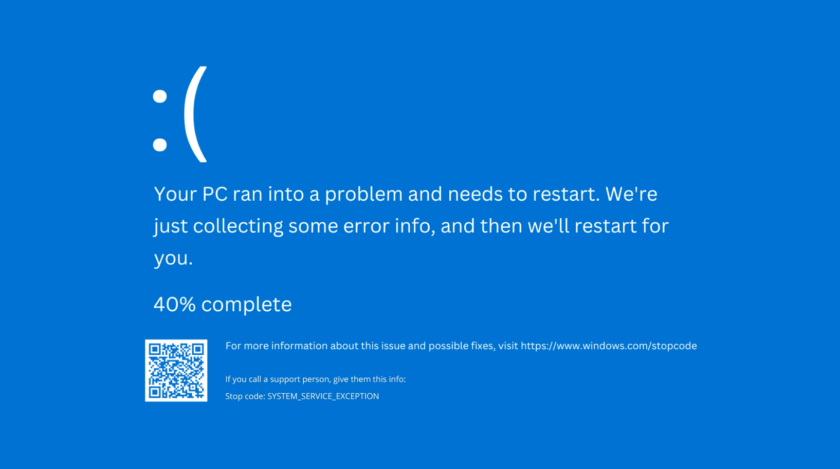

Slide 8
About shellcode…

Slide 9
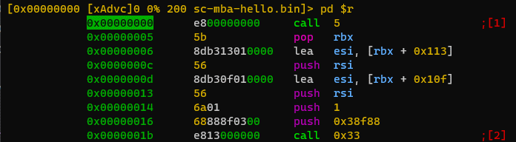

Slide 10
Let’s take an example for running shellcode

Slide 11


Slide 12
FsStackMon
NTSTATUS DriverEntry(
_In_ PDRIVER_OBJECT DriverObject,
_In_ PUNICODE_STRING RegistryPath)
{
gDriverObject = DriverObject;
NTSTATUS status = FltRegisterFilter(
gDriverObject,
&gFilterRegistration,
&gFilterHandle);
The Algorithm
Register MiniFilter & Callbacks
const FLT_REGISTRATION gFilterRegistration = {
sizeof(FLT_REGISTRATION), // Size
FLT_REGISTRATION_VERSION, // Version
0, // Flags
NULL, // Context registration (optional, used for context management)
gCallbacks, // Operation callbacks
FsRegister::FsUnload, // Unload routine
NULL, // Instance setup routine (removed as it's not required)
NULL, // Instance query teardown routine (removed as it's not required)
NULL, // Instance teardown start routine (optional)
NULL, // Instance teardown complete routine (optional)
NULL, // GenerateFileName callback (optional)
NULL, // NormalizeNameComponent callback (optional)
NULL // NormalizeContextCleanup callback (optional) };
CONST FLT_OPERATION_REGISTRATION gCallbacks[] = {
{ IRP_MJ_CREATE, 0, FsCallbacks::FsCbPreOperationCallback, NULL }, // Create operation
//{ IRP_MJ_READ , 0, FsCallbacks::FsCbPreOperationCallback, NULL }, // Read operation
//{ IRP_MJ_WRITE , 0, FsCallbacks::FsCbPreOperationCallback, NULL }, // Write operation
{ IRP_MJ_OPERATION_END } };

Slide 13
FsStackMon
The Algorithm
Create communication port
Receive IRP_MJ_CREATE notifications
NTSTATUS status = FsCommInitializePort(L"\\FsGeorgeMonComm");
FLT_PREOP_CALLBACK_STATUS FsCbPreOperationCallback(
_Inout_ PFLT_CALLBACK_DATA Data,
_In_ PCFLT_RELATED_OBJECTS FltObjects,
_Flt_CompletionContext_Outptr_ PVOID* CompletionContext)
{
PFLT_FILE_NAME_INFORMATION fileNameInfo = NULL;
NTSTATUS status = FltGetFileNameInformation(
Data,
FLT_FILE_NAME_NORMALIZED | FLT_FILE_NAME_QUERY_DEFAULT,
&fileNameInfo);
status = FltParseFileNameInformation(fileNameInfo);
int pid = FltGetRequestorProcessId(Data);

Slide 14
FsStackMon
PVOID backTrace[MAX_STACK_DEPTH];
framesFound = RtlWalkFrameChain(
backTrace,
64, // FramesToCapture
1); // Flags: Userland
MEMORY_BASIC_INFORMATION mbi;
ZwQueryVirtualMemory(
NtCurrentProcess(), // ProcessHandle
backTrace[index], // BaseAddress
MemoryBasicInformation, // MemoryInformationClass
&mbi, // MemoryInformation
sizeof(mbi), // MemoryInformationLength
NULL // ReturnLength );
The Algorithm
If DLL is targeted:
Run Local Stack Analysis.
Query Return Addresses
if ((mbi.Type == MEM_PRIVATE) ||
(mbi.Type == MEM_MAPPED))
{
if ((mbi.Protect == PAGE_EXECUTE) ||
(mbi.Protect == PAGE_EXECUTE_READ) ||
(mbi.Protect == PAGE_EXECUTE_READWRITE) ||
(mbi.Protect == PAGE_EXECUTE_WRITECOPY))
{
// suspicious stack
const UNICODE_STRING gTargetDllList[] = {
RTL_CONSTANT_STRING(L"wininet.dll"),
…

Slide 15
FsStackMon
The Algorithm
Sending the alert to user mode
FsStackMon.sys (kernel mode)
FsStackMonFileLogger (user mode)
PVOID serializedData = ExAllocatePoolWithTag(
NonPagedPool,
MAX_SERIALIZE_BUFFER_SIZE,
FSGEORGEMON_TAG);
NTSTATUS status = FsCommSerializeAlertData(
AlertData,
serializedData);
LARGE_INTEGER timeout;
timeout.QuadPart = -10000 * 1000;
ULONG replyLength = 0;
PVOID replyBuffer = NULL;
status = FltSendMessage(
gFilterHandle, // Filter
&gClientCommPort, // ClientPort
serializedData, // SenderBuffer
serializedDataSize, // SenderBufferLength
replyBuffer, // ReplyBuffer
&replyLength, // ReplyLength
&timeout); // Timeout
struct AlertData {
int Pid;
int AlertType;
std::wstring InfoString; };
struct FilterMessageBuffer {
FILTER_MESSAGE_HEADER MessageHeader;
char Data[4096]; };
FilterConnectCommunicationPort(L"\\FsGeorgeMonComm", 0,
NULL, 0, NULL, &portHandle);
FilterMessageBuffer messageBuffer;
while (true)
{
HRESULT hr2 = FilterGetMessage(
portHandle, // hPort
&messageBuffer.MessageHeader, // lpMessageBuffer
sizeof(messageBuffer), // dwMessageBufferSize
NULL); // lpOverlapped
if (SUCCEEDED(hr2))
{
AlertData receivedAlert;
DeserializeAlert(messageBuffer.Data, receivedAlert);
WriteAlertToFile(receivedAlert);

Slide 17
CbStackMon
The Algorithm
Subscribe to Thread Creation.
Check for target protected process.
Store threads.
PsSetCreateThreadNotifyRoutine(
CallbackThreadCreate::CbThreadCreateRoutine);
VOID CbThreadCreateRoutine(
_In_ HANDLE ProcessId,
_In_ HANDLE ThreadId,
_In_ BOOLEAN Create
)
{
PEPROCESS process;
NTSTATUS status = PsLookupProcessByProcessId(
ProcessId,
&process);
PUNICODE_STRING processImageName;
status = SeLocateProcessImageName(
process,
&processImageName);
for (int i = 0; i < MAX_THREADS; i++)
{
if (gThreadArray[i] == NULL)
{
gThreadArray[i] = ThreadId;
break;
}
}

Slide 18
CbStackMon
VOID
CbModuleLoadRoutine(
_In_opt_ PUNICODE_STRING FullImageName,
_In_ HANDLE ProcessId,
_In_ PIMAGE_INFO ImageInfo)
{
for (int i = 0; i < MAX_THREADS; i++)
{
apc = (PKAPC)ExAllocatePoolWithTag(
NonPagedPool,
sizeof(KAPC),
MEMORY_TAG);
KeInitializeApc(
apc,
thread,
OriginalApcEnvironment,
(PKKERNEL_ROUTINE)SaAnalysisApcRoutine,
// special kernel APC
NULL, NULL, KernelMode,
Context // analysis context
);
KeInsertQueueApc(
apc,
Context,
NULL,
0)
The Algorithm
Subscribe to Module Loads
For each targeted module:
Queue analysis APC on each thread
PsSetLoadImageNotifyRoutine(
CallbackModuleLoad::CbModuleLoadRoutine);
const UNICODE_STRING gTargetDllList[] = {
RTL_CONSTANT_STRING(L"wininet.dll"),
…};

Slide 19
CbStackMon
VOID
SaAnalysisApcRoutine(
PKAPC Apc,
PKNORMAL_ROUTINE* NormalRoutine,
PVOID* NormalContext,
PVOID* SystemArgument1,
PVOID* SystemArgument2 )
{
// This is the code "injected" via APC
PANALYSIS_CONTEXT context = (PANALYSIS_CONTEXT)Apc->SystemArgument1;
context->Result = SaLocalAnalysis(context->Pid);
KeSetEvent(
&context->CompletionEvent,
IO_NO_INCREMENT,
FALSE);
ExFreePool(Apc);
}
The Algorithm
Analyze stack
RtlWalkFrameChain
ZwQueryVirtualMemory
Writes alerts to c:\Windows\alerts.txt

Slide 21
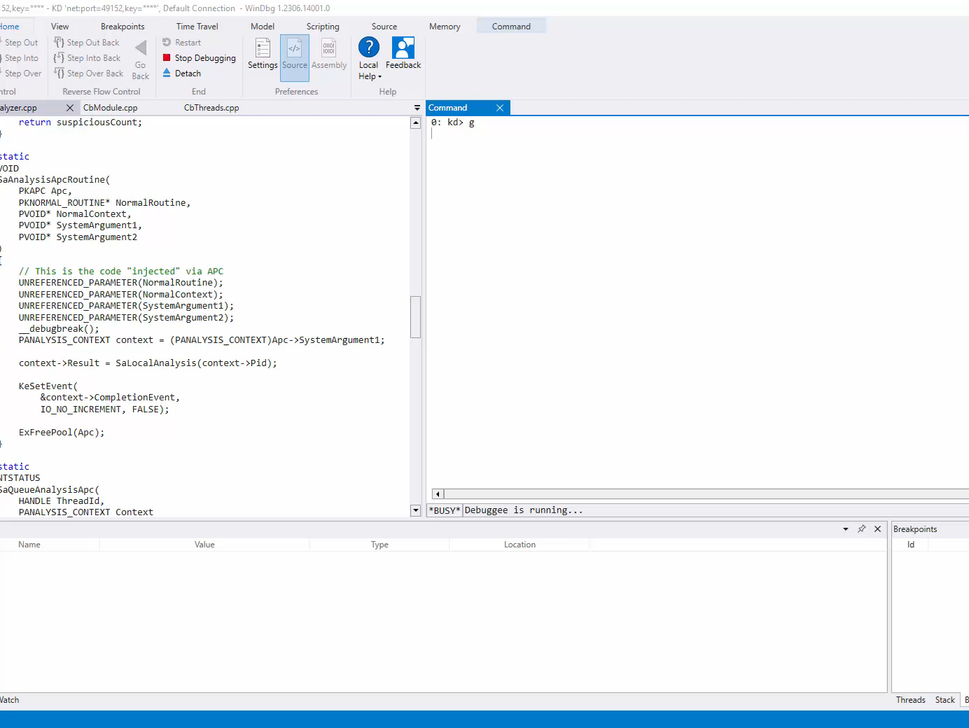

Slide 22
Mini-Inject
The Algorithm
Subscribe: Process Create
New process -> does the name contain “protected”? If yes -> monitor
PsSetCreateProcessNotifyRoutine(
Callbacks::CbProcessCreate, // NotifyRoutine
FALSE // Remove
);
void Callbacks::CbProcessCreate(
_In_ HANDLE ParentPid,
_In_ HANDLE ProcessPid,
_In_ BOOLEAN Create)
{
PsLookupProcessByProcessId(ProcessPid, &process);
SeLocateProcessImageName(process, &processName);
…

Slide 23
Mini-Inject
The Algorithm
Subscribe: Module Loads
When kernel32.dll module is loaded:
Save address of LoadLibraryW by parsing the export directory of kernel32.dll
PsSetLoadImageNotifyRoutine(
Callbacks::CbImageLoad // NotifyRoutine
);
void Callbacks::CbImageLoad(
_In_ PUNICODE_STRING ImageName,
_In_ HANDLE Pid,
_In_ PIMAGE_INFO ImageInfo
)
{
LoadLibraryW = Helpers::HlpKernelGetExportedProcAddress(
ImageInfo->ImageBase,
"LoadLibraryW“
);

Slide 24
Mini-Inject
The Algorithm
On next loaded module after kernel32.dll:
5.3 Queue the APC and force it’s execution
5.1 Allocate Memory for DLL Name
5.2 Allocate and initialize APC object
ZwAllocateVirtualMemory(
ZwCurrentProcess(),
&umAddress,
0,
&Size,
MEM_COMMIT,
PAGE_EXECUTE_READWRITE
);
RtlZeroMemory(
umAddress,
Size
);
PKAPC Apc = (PKAPC)ExAllocatePool(
NonPagedPool,
sizeof(KAPC)
);
KeInitializeApc(
Apc,
PsGetCurrentThread(),
CurrentApcEnvironment,
(PKKERNEL_ROUTINE)InjpInjectApcKernelRoutine,
NULL,
(PKNORMAL_ROUTINE)LoadLibraryW,
UserMode,
umAddress
);
KeInsertQueueApc(
Apc,
NULL,
NULL,
0
);
KeTestAlertThread(UserMode);

Slide 25
Mini-Inject UM DLL
FARPROC WINAPI DtrGetProcAddress(
_In_ HMODULE hModule,
_In_ LPCSTR lpProcName)
{
StackAnalyzerClassifier();
// log message
return OrigGetProcAddress(hModule, lpProcName);
}
HMODULE WINAPI DtrLoadLibraryA(
_In_ LPCSTR lpLibFileName
)
{
StackAnalyzerClassifier();
// log message
return OrigLoadLibraryA(lpLibFileName);
}
The Algorithm
Hook on shellcode used routines.
LoadLibrary.
GetProcAddress.
BOOL APIENTRY DllMain(
HMODULE hModule,
DWORD ul_reason_for_call,
LPVOID lpReserved
)
{
switch (ul_reason_for_call)
{
case DLL_PROCESS_ATTACH:
DtrTrap::DeployDtrTrap();
case DLL_THREAD_ATTACH:
case DLL_THREAD_DETACH:
case DLL_PROCESS_DETACH:
break;
}
return TRUE;
}
void DeployDtrTrap()
{
DetourRestoreAfterWith();
DetourTransactionBegin();
DetourUpdateThread(GetCurrentThread());
DetourAttach(&(PVOID&)OrigGetProcAddress, DtrGetProcAddress);
DetourAttach(&(PVOID&)OrigLoadLibraryA, DtrLoadLibraryA);
DetourTransactionCommit();
}

Slide 26
Mini-Inject UM DLL
BOOL StackAnalyzerClassifier()
{
PVOID stackTrace[32];
USHORT framesCaptured = CaptureStackBackTrace(
0, // FramesToSkip
32, // FramesToCapture
stackTrace, // BackTrace
NULL); // BackTraceHash
for (USHORT i = 0; i < framesCaptured; i++)
{
PVOID returnAddress = stackTrace[i];
MEMORY_BASIC_INFORMATION memInfo;
SIZE_T queried = VirtualQueryEx(
GetCurrentProcess(), // hProcess
returnAddress, // lpAddress
&memInfo, // lpBuffer
sizeof(memInfo)); // dwLength
if (memInfo.Type == MEM_PRIVATE)
{
// called from private mem
}
}
}
The Algorithm
Stack analysis based on the hooks.
Memory Query.

Slide 28
ObRegMon
The Algorithm
Subscribe to Process Notification
Maintain a monitored process management system.
NTSTATUS status = PsSetCreateProcessNotifyRoutine(
Process::CbProcessNotifyCallback,
FALSE);
void Process::CbProcessNotifyCallback(
_In_ HANDLE ParentId,
_In_ HANDLE ProcessId,
_In_ BOOLEAN Create)
{
// open a log file for each process
// keep track of each pid + log file handle

Slide 29
ObRegMon
The Algorithm
Register for Object notifications
operations[0].ObjectType = PsProcessType;
operations[0].Operations = OB_OPERATION_HANDLE_CREATE | OB_OPERATION_HANDLE_DUPLICATE;
operations[0].PreOperation = CbObPreOperationCallback;
operations[1].ObjectType = PsThreadType;
operations[1].Operations = OB_OPERATION_HANDLE_CREATE | OB_OPERATION_HANDLE_DUPLICATE;
operations[1].PreOperation = CbObPreOperationCallback;
callbackRegistration.Version = OB_FLT_REGISTRATION_VERSION;
callbackRegistration.OperationRegistrationCount = 2;
callbackRegistration.RegistrationContext = NULL;
RtlInitUnicodeString(&altitude, L"32000");
callbackRegistration.Altitude = altitude;
callbackRegistration.OperationRegistration = operations;
NTSTATUS status = ObRegisterCallbacks(&callbackRegistration, &gRegistrationHandle);

Slide 30
ObRegMon
The Algorithm
Monitor object handle creation and handle duplication
OB_PREOP_CALLBACK_STATUS Object::CbObPreOperationCallback(
_In_opt_ PVOID RegistrationContext,
_Inout_ POB_PRE_OPERATION_INFORMATION OperationInformation)
{
if (OperationInformation->ObjectType == *PsProcessType ||
OperationInformation->ObjectType == *PsThreadType)
{
// get operation type (handle/duplication) from OperationInformation->Operation
// get handle id of opened process or thread
HANDLE id = (OperationInformation->ObjectType == *PsProcessType) ?
PsGetProcessId((PEPROCESS)OperationInformation->Object) :
PsGetThreadId((PETHREAD)OperationInformation->Object);
// get the process which performs the operation
HANDLE openingProcessId = PsGetCurrentProcessId();
// log the action

Slide 31
ObRegMon
UNICODE_STRING altitude = RTL_CONSTANT_STRING(L"370000");
NTSTATUS status = CmRegisterCallbackEx(
CbCmRegistryCallback, // Function
&altitude, // Altitude
DriverObject, // Driver
NULL, // Context
&gRegCallbackCookie, // Cookie
NULL // Reserved
);
The Algorithm
Register for Registry notification
NTSTATUS Registry::CbCmRegistryCallback(
_In_ PVOID CallbackContext,
_In_opt_ PVOID Argument1,
_In_opt_ PVOID Argument2)
{
REG_NOTIFY_CLASS notifyClass = (REG_NOTIFY_CLASS)(ULONG_PTR)Argument1;
if (notifyClass == RegNtPreSetValueKey)
{
PREG_SET_VALUE_KEY_INFORMATION setValueInfo = (PREG_SET_VALUE_KEY_INFORMATION)Argument2;
if (setValueInfo && setValueInfo->ValueName)
{
HANDLE openingProcessId = PsGetCurrentProcessId();
// log the registry action

Slide 34
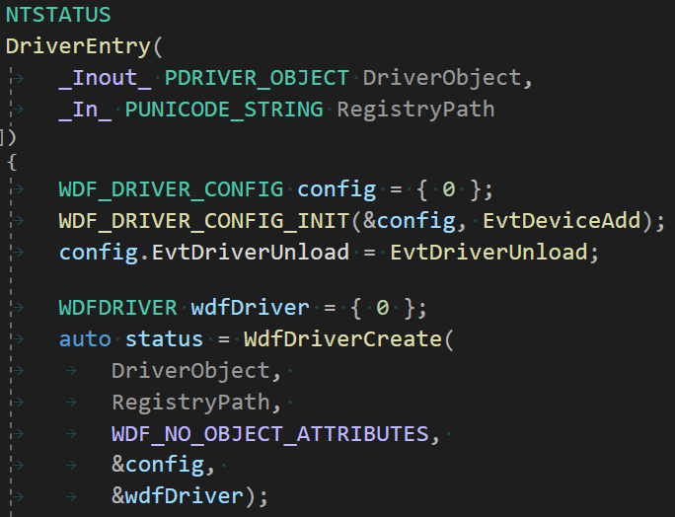
Keylogger
The Algorithm
To use KMDF, must call WdfDriverCreate
Create driver with config (DeviceAdd + DriverUnload)

Slide 35
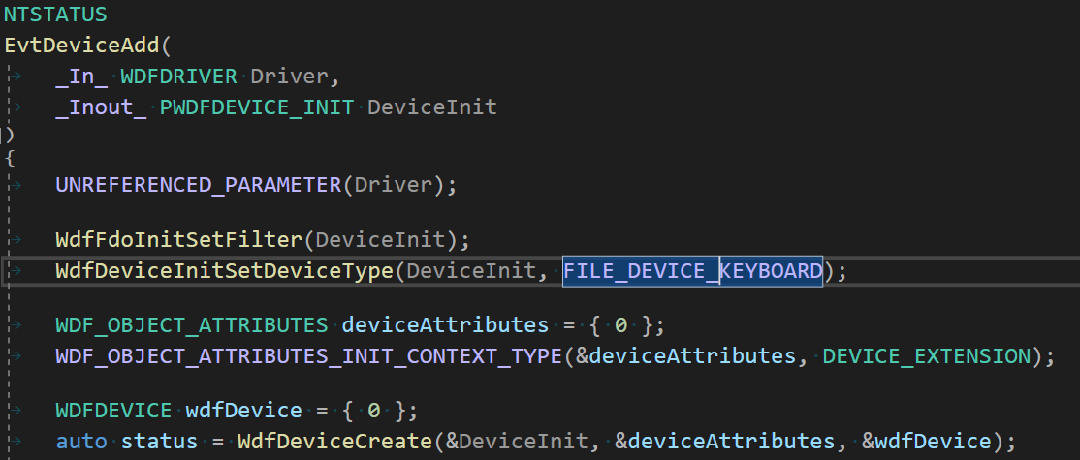
Keylogger
On device add callback, create device
The algorithm

Slide 36
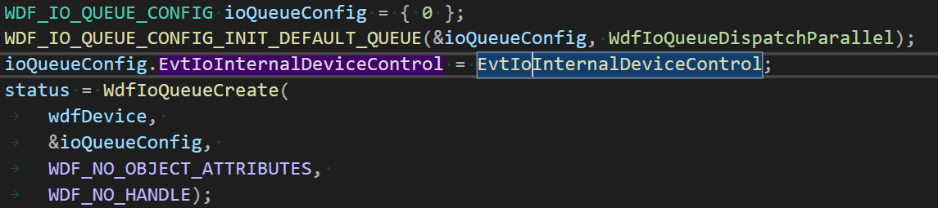
Keylogger
The algorithm
Create I/O queue for processing I/O requests
Set the InternalDeviceControl callback

Slide 37
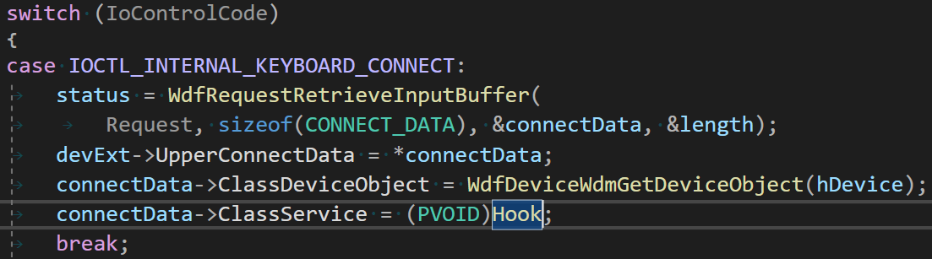
Keylogger
The algorithm
On KEYBOARD_CONNECT, set the ClassService callback to our hook

Slide 38
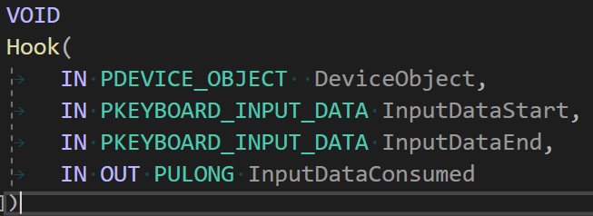
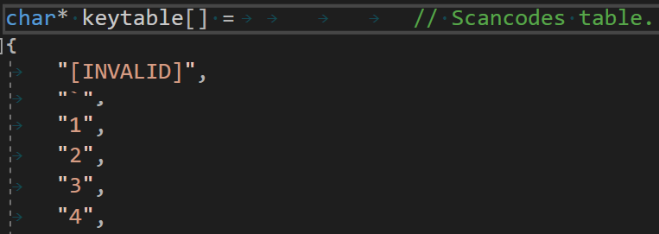
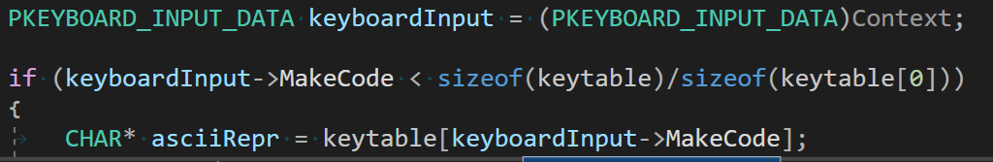
Keylogger
The algorithm
Take the MakeCode from PKEYBOARD_INPUT_DATA and convert the scancode into ASCII

Slide 40
Thank You!

